Slide 1
Sparkling Wine Sales
Time Series project

Slide 2
Description
ABC Estate Wines has been a leader in the wine industry for many years, offering high-quality wines to consumers all around the world. As the company continues to expand its reach and grow its customer base, it is essential to analyze market trends and forecast future sales to ensure continued success. In this project, we will focus on analyzing the sales data for sparkling wine in the 20th century.

Slide 3


EXPLORATORY DATA ANALYSIS
count | 187.000000
mean | 2402.417112
std | 1295.111540
min | 1070.000000
25% | 1605.000000
50% | 1874.000000
75% | 2549.000000
max | 7242.00000
Descriptive statistics of sales
There are no null values present in the dataset.
1525 rows and 9 columns

Slide 4
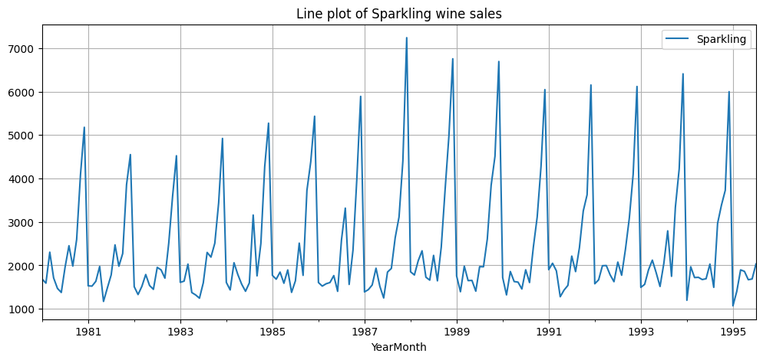
LINE PLOT
The data shows that sales of wine increased steadily over this 15-year period, from approximately 2,000 units in 1981 to over 6,000 units in 1995.

Slide 5
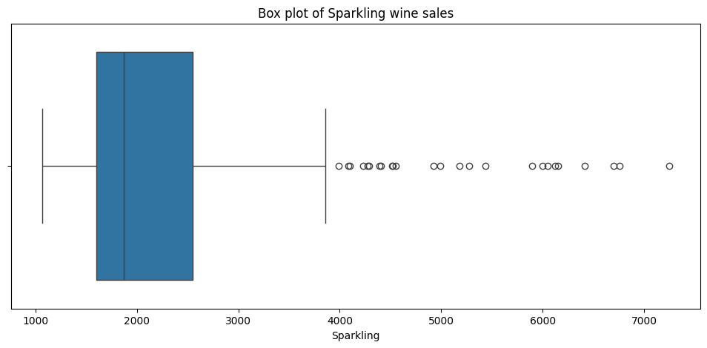
Box Plot of SALES
The wine sales data exhibits a skewed distribution with high variability, characterized by a wide range of values and the presence of outliers.

Slide 6
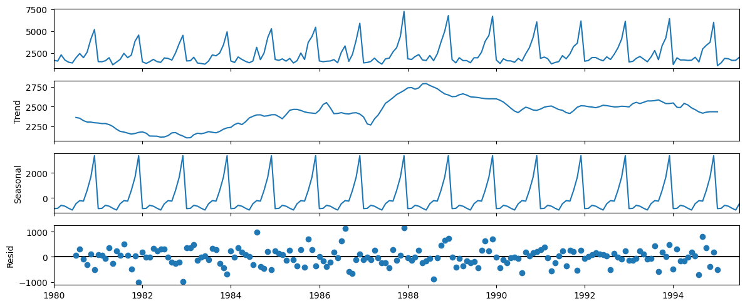
ADDITIVE DECOMPOSITION
Sales peaked in 1988 – 1989
The sales trend can be characterized as a U-shaped trend with an initial decline, followed by a recovery, a peak, and another decline.
In additive decomposition the points are scattered everywhere but can be fitted between two parallel lines.

Slide 7
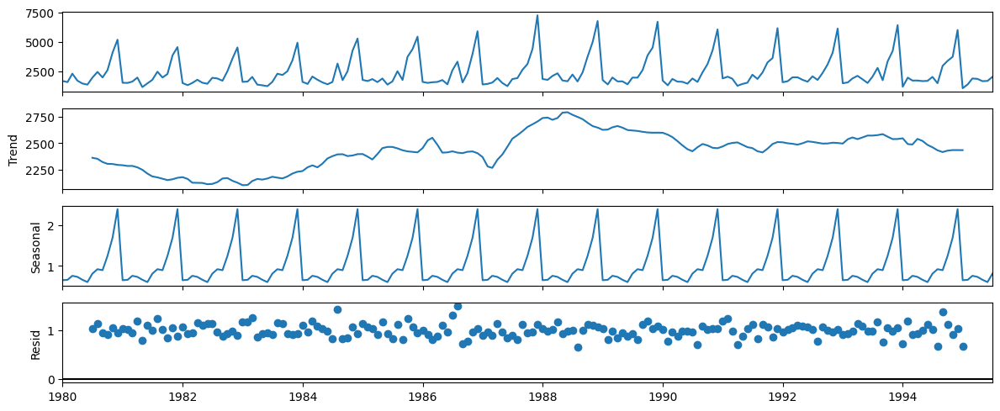
MULTIPLICATIVE DECOMPOSITION
Both trend and seasonal are present
The residual points in multiplicative decomposition tend to align in a straight line, while those in additive decomposition scatter more widely, suggests that the multiplicative model better captures the underlying relationship between the trend, seasonality, and residuals in the time series data

Slide 8
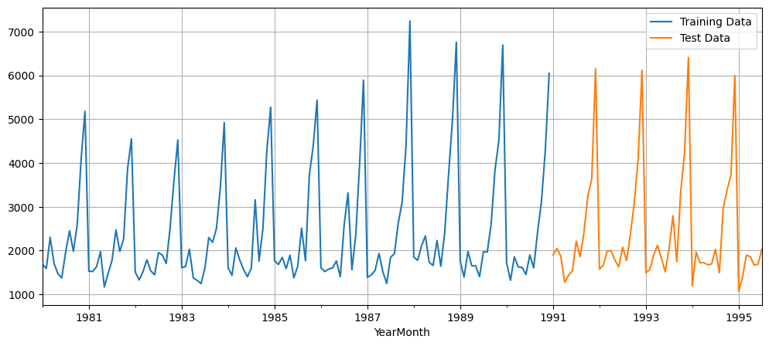
LINE PLOT OF TRAINING AND Test DATA
Dataset is divided into two distinct periods for the purpose of assessing the model’s effectiveness.
Training set, which starts from January 1980 to December 1990, is utilized to calibrate the model. Meanwhile, the test set, which covers the period from January 1991 to July 1995, is employed to gauge the model’s predictive accuracy.

Slide 9
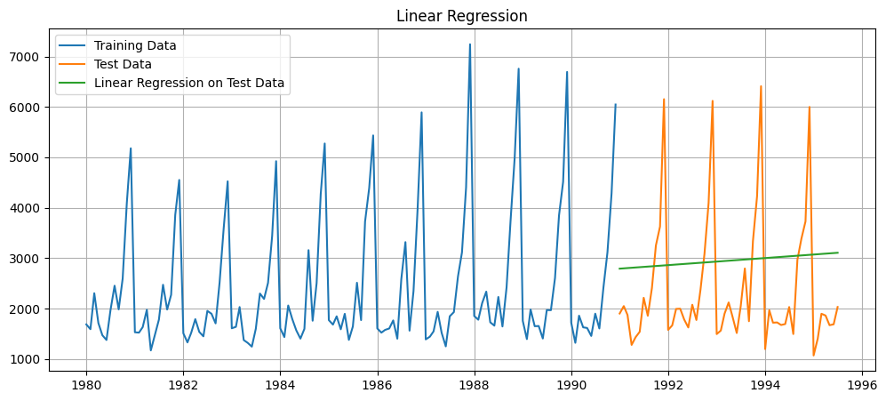
Linear regression
Green line represents the predicated values from Linear regression model.
Root Mean Square Error (RMSE) value of 1389 which is high.
Predicated values are very far from actual values.

Slide 10
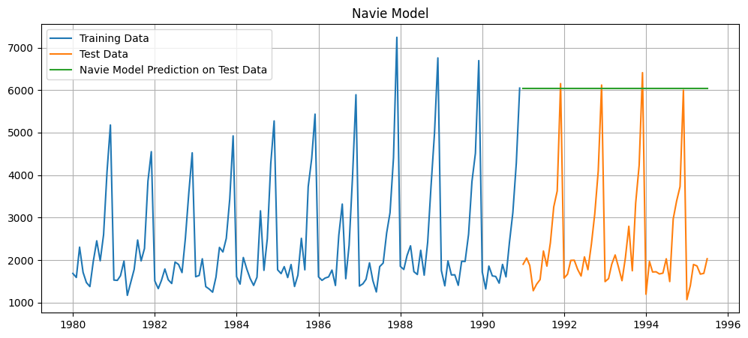
NAVIE MODEL
Green line represents the predicated values from Navie model.
Root Mean Square Error (RMSE) value of 3864 which is high.
Predicated values are very far from actual values.

Slide 11
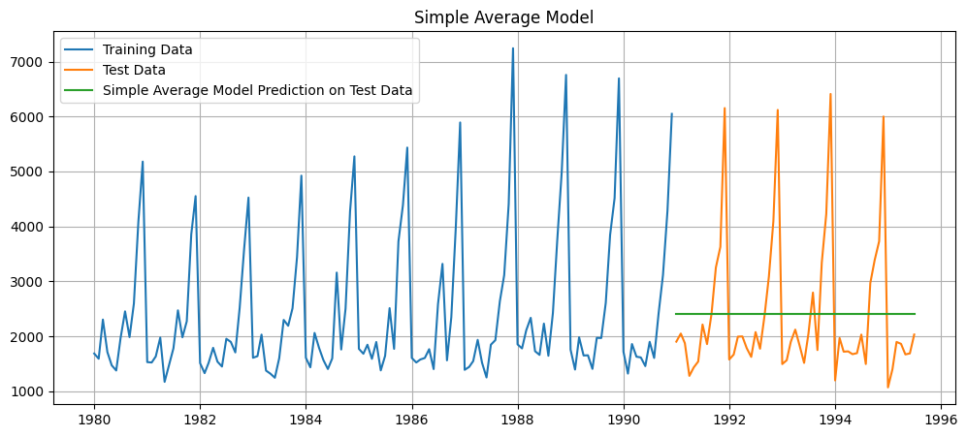
SIMPLE AVERAGE MODEL
Green line represents the predicated values from Simple average model.
Root Mean Square Error (RMSE) value of 1275 which is high.
Predicated values are very far from actual values.

Slide 12
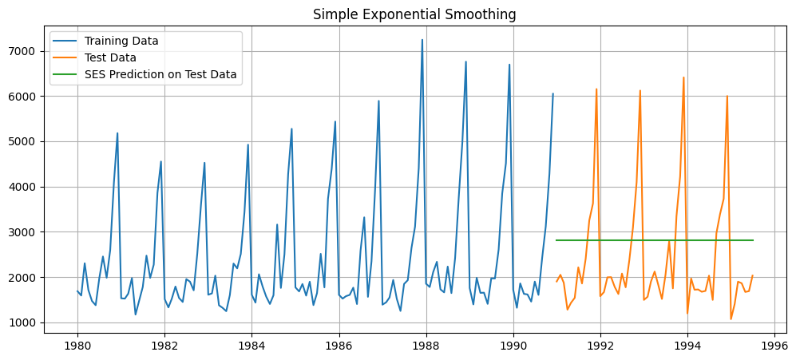
Single Exponential Smoothing
Green line represents the predicated values from Simple Exponential Smoothing model.
Root Mean Square Error (RMSE) value of 1338 which is high.
Predicated values are very far from actual values.

Slide 13
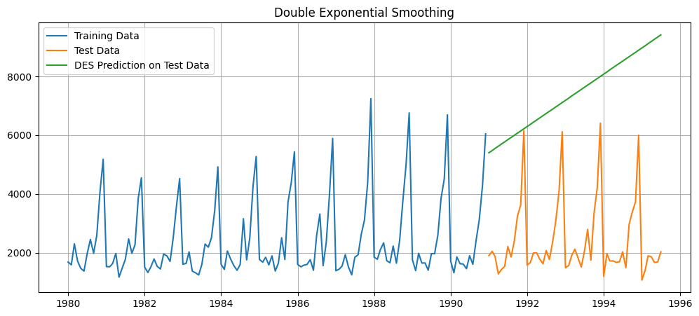
Double Exponential Smoothing
Green line represents the predicated values from Double Exponential Smoothing model.
Root Mean Square Error (RMSE) value of 1338 which is high.
Predicated values are very far from actual values.

Slide 14
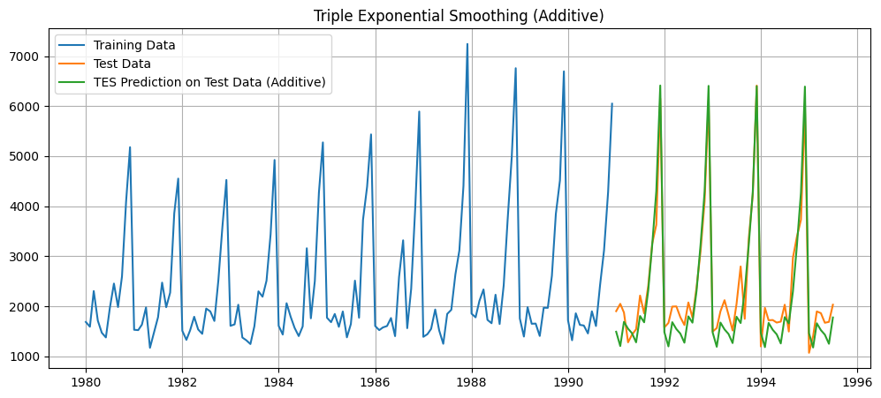
Triple Exponential Smoothing (Additive)
Green line represents the predicated values from Triple Exponential Smoothing Additive model.
Root Mean Square Error (RMSE) value of 378 .
Predicated values are slightly differed from actual values.

Slide 15
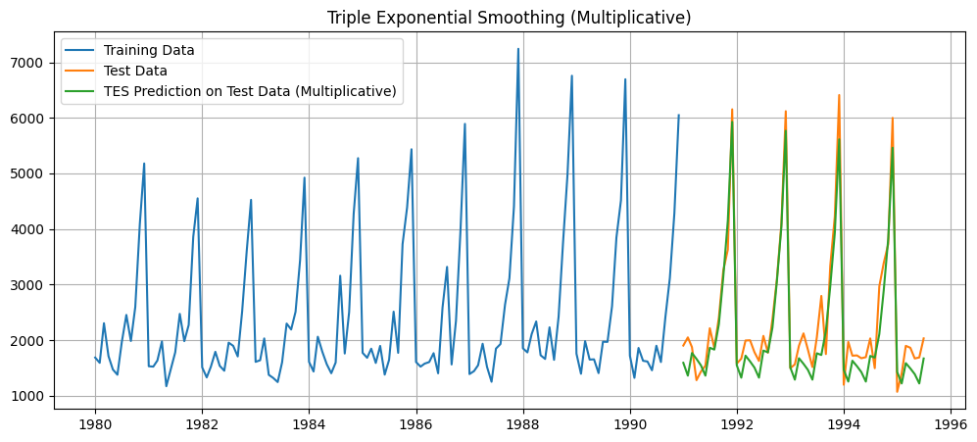
Triple Exponential Smoothing (Multiplicative)
Green line represents the predicated values from Triple Exponential Smoothing Multiplicative model.
Root Mean Square Error (RMSE) value of 317 for smoothing values Alpha=0.4,Beta=0.1,Gamma=0.2.

Slide 16
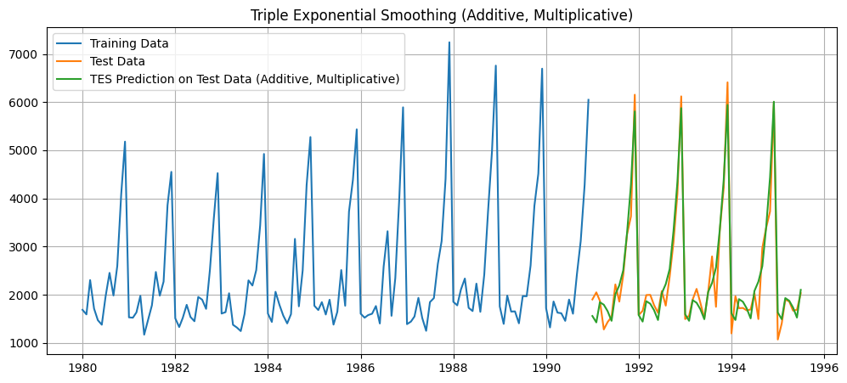
Triple Exponential Smoothing (Additive, Multiplicative)
Green line represents the predicated values from Triple Exponential Smoothing (Trend – Additive, Seasonal – Multiplicative) model.
Root Mean Square Error (RMSE) value of 380 which is high.
Predicated values are slightly differed from actual values.

Slide 17
Summary
Models | Test RMSE
Linear Regression | 1389.135174897992
Navie Model | 3864.2793518443914
Simple Average Model | 1275.0818036965309
Simple Exponential Smoothing | 1338.0046232563645
Double Exponential Smoothing | 5291.879833226911
Triple Exponential Smoothing Forecast (Additive) | 378.6262408893861
Triple Exponential Smoothing Forecast (Multiplicative) | 380.3928248482875
Alpha=0.4,Beta=0.1,Gamma=0.2 Triple Exponential Smoothing Forecast (Additive, Multiplicative) | 317.43430200265
It is clear from the RMSE value that the Holt-Winters' additive method (317.43) is the best method for predicting the future data for 12 months.
The Holt-Winters' additive method is a powerful forecasting tool that can be used to predict future wine sales. By using this model, ABC Estate Wines can make informed decisions about marketing, production, and pricing to maximize sales.

Slide 18
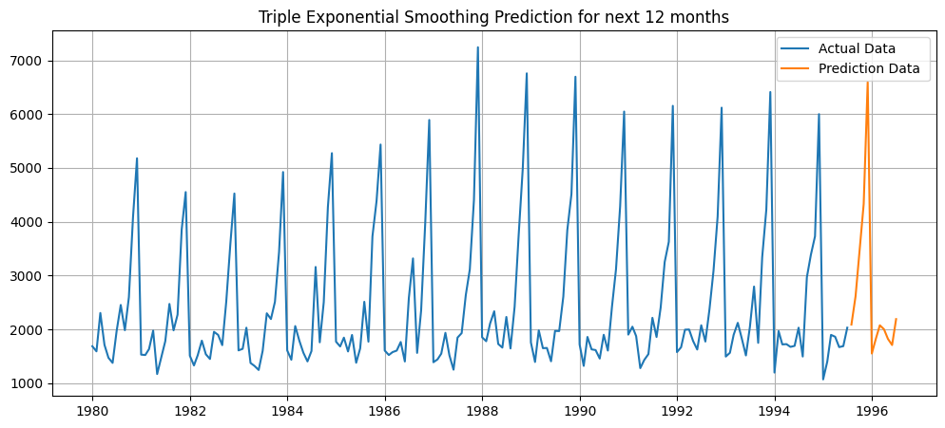
Prediction for FUTURE (12 Months)
Orange lines represents predictions for future 12 months using Triple Exponential Smoothing model (Trend – Additive, Seasonal – Multiplicative) for smoothing values Alpha = 0.4, Beta = 0.1, Gamma = 0.2.

